Slide 1
SALES FORECASTING

Slide 2


SALES FORECASTING
It is determining present-day or future sales using data like past sales, seasonality, festivities, economic conditions, etc.
So, this model will predict sales on a certain day after being provided with a certain set of inputs.

Slide 3



6 PARAMETERS
past seven day sales
day of the week
date – the date was transformed into 3 different inputs
season
Festival or not
sales on the same day in the previous year

Slide 4



HOW DOES IT WORK4
First, all inputs are preprocessed to be understandable by the machine. This is a linear regression model based on supervised learning, so the output will be provided along with the input. Then inputs are then fed to the model along with desired output. The model will plot(learn) a relation(function) between the input and output. This function or relation is then used to predict the output for a specific set of inputs. In this case, input parameters like date and previous sales are labeled as input, and the amount of sales is marked as output. The model will predict a number between 0 and 1 as a sigmoid function is used in the last layer. This output can be multiplied by a specific number(in this case, maximum sales), this will be our corresponding sales amount for a certain day. This output is then provided as input to calculate sales data for the next day. This cycle of steps will be continued until a certain date arrives.

Slide 5


REQUIRED PACKAGES AND INSTALLATION
Prophet
numpy
pandas
csv
matplotlib.pyplot

Slide 6


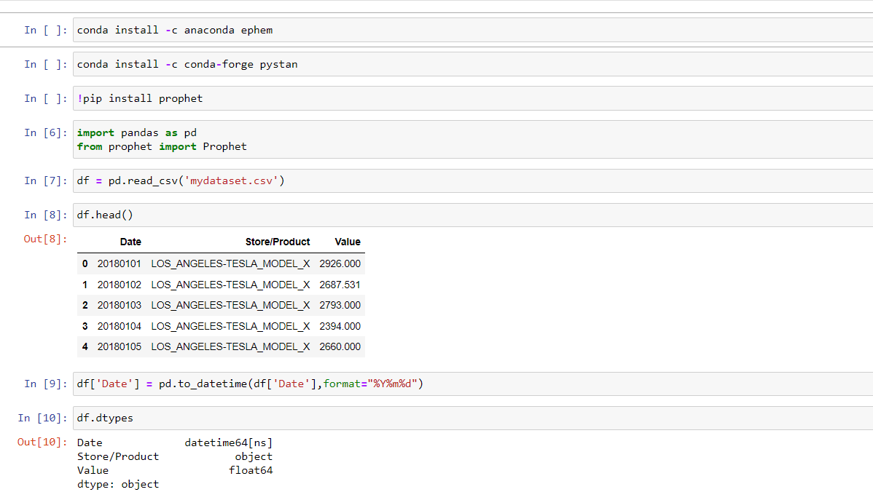



Slide 7
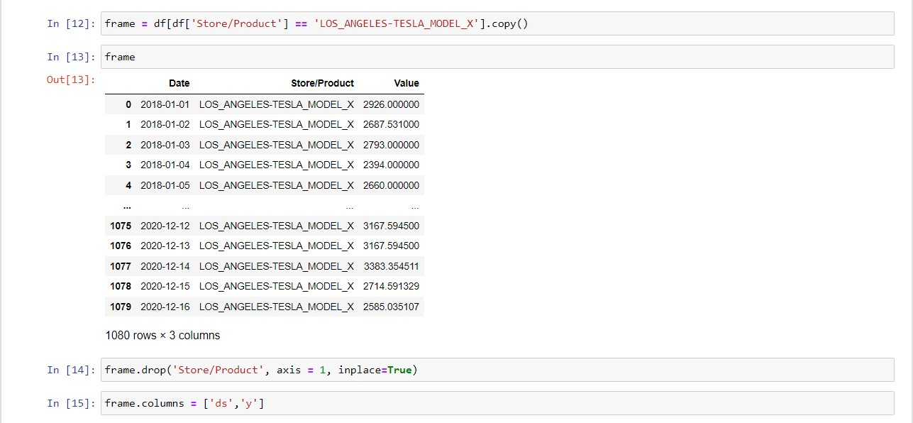

Slide 8
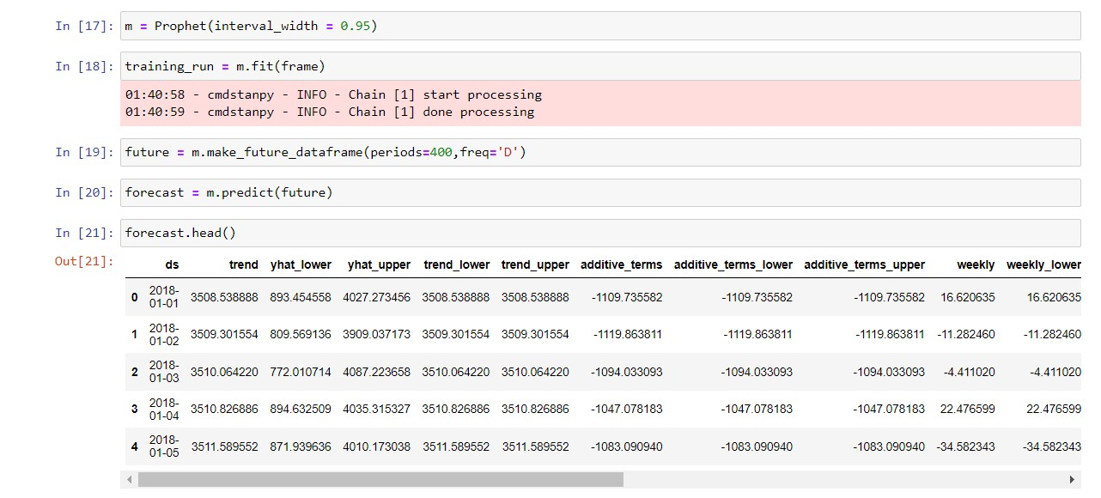

Slide 9
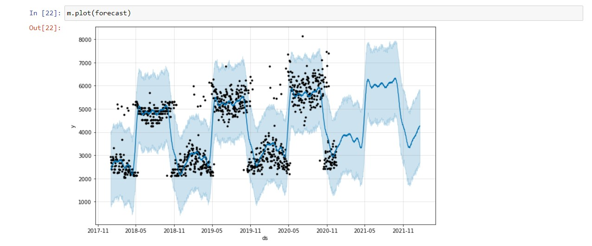

Slide 10
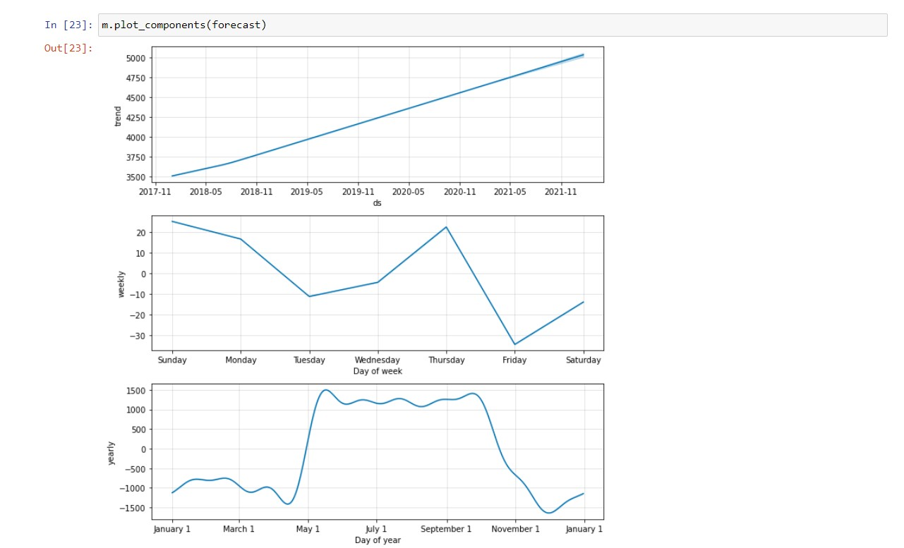

Slide 11


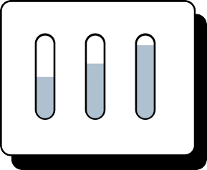


THANK YOU
By:-
DARSHIL KANTARIYA [RA2011042010084] YUVRAJ DEVNANI [RA2011042010098]

